Slide 1




NeuroDetect: AI-Powered EEG Analysis for Early Detection of Alzheimer’s & Depression

Slide 2

ABTSRACT
NeuroDetect is an intelligent EEG-based diagnostic support system designed to identify early neurodegenerative patterns associated with Alzheimer’s disease and mood-related cognitive decline.
By combining advanced signal processing, machine learning, and a web-driven interface, the system extracts neural biomarkers such as Alpha Power, Coherence, and Hemispheric Asymmetry.
These indicators are analyzed through a clinically interpretable classification engine, enabling fast, cost-effective, and non-invasive assessments.
The project bridges the gap between raw neurophysiological data and actionable clinical insights.

Slide 3


WHY NEURODETECT?
Traditional diagnosis often detects cognitive decline too late.
PET/MRI scans are costly, invasive, and not accessible for routine screening.
EEG signals contain early biomarkers but are rarely analyzed quantitatively in clinics.
Physicians require reliable, automated tools that simplify neurodiagnostic workflows.
NeuroDetect fills this gap with a fast, accurate, and interpretable AI-powered evaluation system.

Slide 4
INTRODUCTION
Neurological disorders such as Alzheimer’s and Depression are rising globally, yet early diagnosis remains difficult due to subjective assessments and expensive imaging technologies.
EEG offers a unique, non-invasive window into brain function, but manual interpretation requires expertise and time.
NeuroDetect addresses this challenge by automating EEG analysis using AI-driven feature extraction and classification, packaged in an easy-to-use web interface for clinicians, labs, and research institutions.

Slide 5
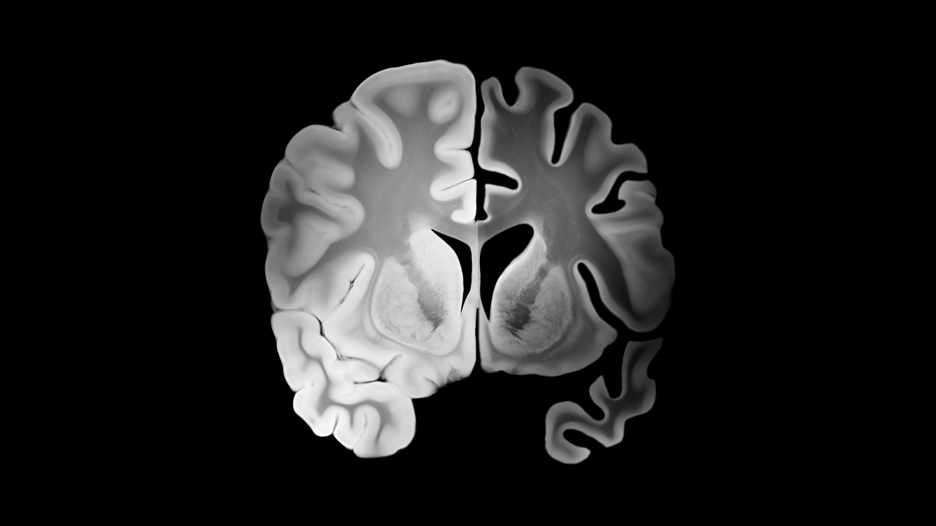
PROJECT FEATURES
Automated EEG Upload
and Validation
Alzheimer’s Classifier Using Centroid-Based ML
Depression Risk Prediction via Alpha Asymmetry
Interactive Dashboards & PDF Report Generation

Slide 6

EXISTING SYSTEM
Current neurodiagnostic systems rely heavily on:
Clinical interviews & cognitive questionnaires
Manual interpretations of EEG waveforms
Costly MRI/PET imaging for advanced cases
Offline MATLAB/MNE analysis requiring skilled technicians
These approaches are slow, subjective, and unsuitable for mass screening.

Slide 7


DISADVANTAGES
Late detection window for Alzheimer’s
High dependency on neurologist interpretation
No automated insight extraction from EEG
Expensive imaging infrastructure
Lack of differential diagnostics between Depression and Alzheimer’s
Non-standardized reporting, causing inconsistencies

Slide 8
COMPARISON
 | PROPOSED SYSTEM (NeuroDetect) | EXISTING SYSTEM (Traditional)
ACCURACY | High - 97 % (Objective) Utilizes consistent mathematical biomarkers (Alpha Power, Coherence, Asymmetry) to reduce human error. | Variable - 85% (Subjective) Heavily dependent on clinician experience and patient self-reporting (e.g., PHQ-9, MMSE).
Prediction Approach | Hybrid Computational Model | Manual Diagnosis
Use of Technology | Automated Signal Processing | Manual or Invasive
User Interaction | Interactive Digital Dashboard | Static/Non-Interactive
Scope of Detection | Dual-Pathology Screening | Single-Focus Monitoring

Slide 9



PROPOSED SYSTEM

Slide 10
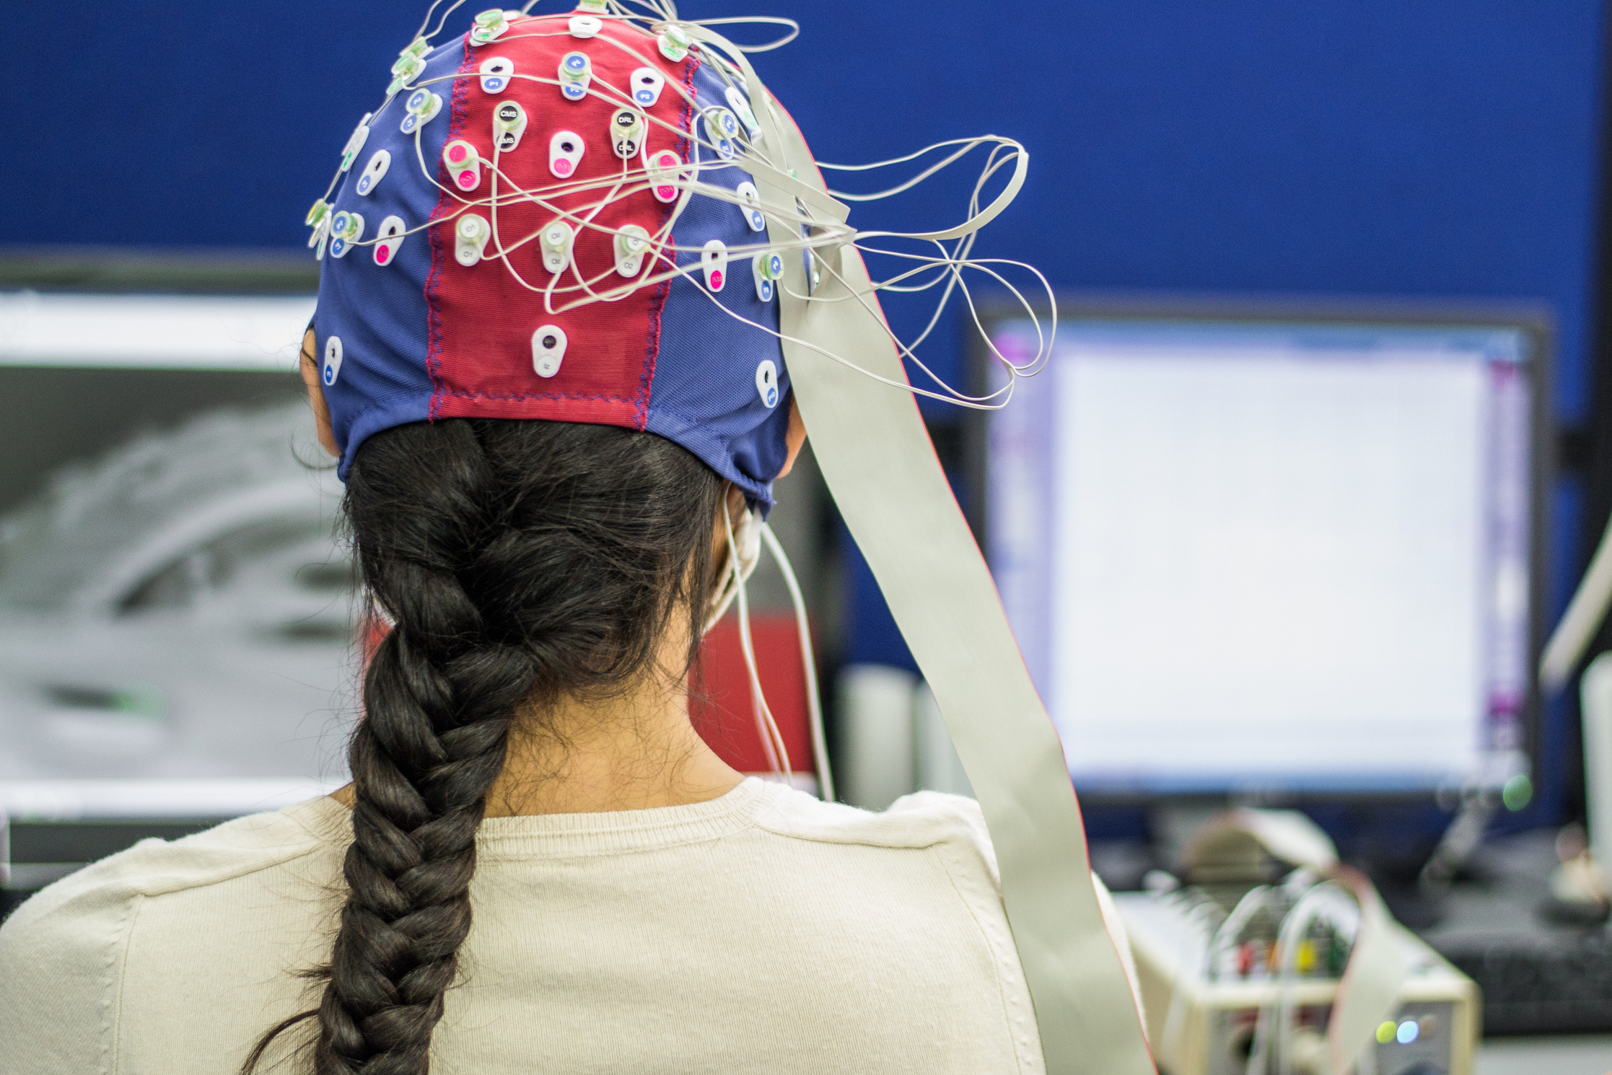

PROPOSED SYSTEM
The Diagnostic Gap:
Late Detection: Alzheimer's Disease (AD) is often diagnosed only after significant cognitive decline has occurred.
Accessibility: Gold-standard diagnostics (PET Scans, Cerebrospinal Fluid analysis) are invasive, expensive, and not widely available.
Subjectivity: Standard cognitive tests (MMSE) can be influenced by education level and language barriers.

Slide 11
PROPOSED SYSTEM
The Solution:
An automated, non-invasive screening tool using resting-state EEG.
Uses signal processing to detect the "slowing" and "disconnection" characteristic of AD pathology.
Pathological Indicators in EEG:
"EEG Slowing":
AD patients typically exhibit a reduction in high-frequency power (Alpha/Beta) and an increase in low-frequency power (Theta/Delta).
Our Focus: Monitoring Alpha Band (8-12 Hz) power in Occipital regions (O1, O2), which is often reduced in early AD.

Slide 12
PROPOSED SYSTEM
"Disconnection Syndrome":
AD causes synaptic loss, leading to reduced functional connectivity between brain regions.
Our Focus: Measuring Coherence (synchronization) between Frontal (Fz) and Occipital (O1/O2) regions.
Feature Extraction: The system extracts 4 key features from the EEG signal:
Alpha Power (O1): Left Occipital activity.
Alpha Power (O2): Right Occipital activity.
Coherence (O1-Fz): Left-Frontal connectivity.
Coherence (O2-Fz): Right-Frontal connectivity.

Slide 13
PROPOSED SYSTEM
Classification Strategy:
Epoching: The signal is sliced into 10-second segments (Epochs).
Centroid Vote-Based Classification:
Each 10s epoch is individually classified as "Control" or "Abnormal" using a pre-trained model (classifier 1.pkl).
Final Result: The system calculates the percentage of abnormal epochs to generate a confidence score (e.g., “95% Abnormal").
Diagnostic Dashboard:
Biomarker Table: Displays the raw calculated values for Alpha Power and Coherence, providing transparency for clinicians.
Visual Verification: Renders the actual EEG waveform plot (matplotlib) to ensure signal quality was sufficient.
PDF Report: Auto-generates a downloadable clinical report using html2pdf.js.

Slide 14
PROPOSED SYSTEM
Automated Decision Support: The system interprets the percent_abnormal score to suggest interventions:
If Abnormality Detected (>50%):
Neurology Referral: Schedule MRI/PET to confirm atrophy.
💊 Medication Review: Evaluate current prescriptions for cognitive impact.
Lifestyle: Recommend the MIND diet (Mediterranean-DASH Intervention for Neurodegenerative Delay).
If Normal Pattern (<50%):
📅 Monitoring: Continue annual cognitive screenings.
🏃 Prevention: Maintain aerobic activity levels to support neuroplasticity.

Slide 15
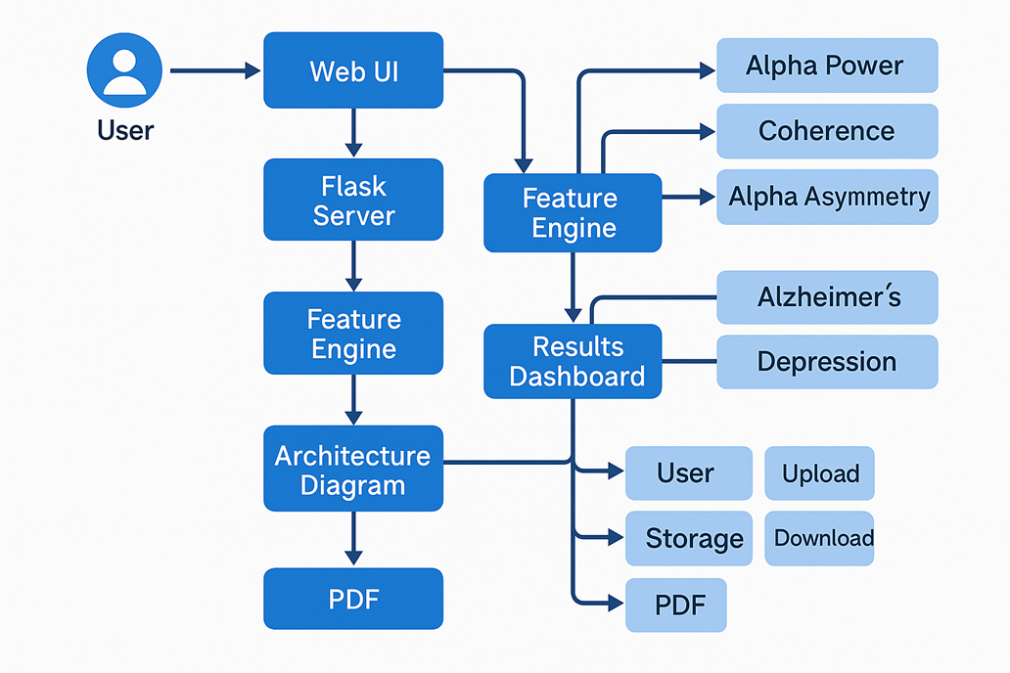
ARCHITECTURE

Slide 16
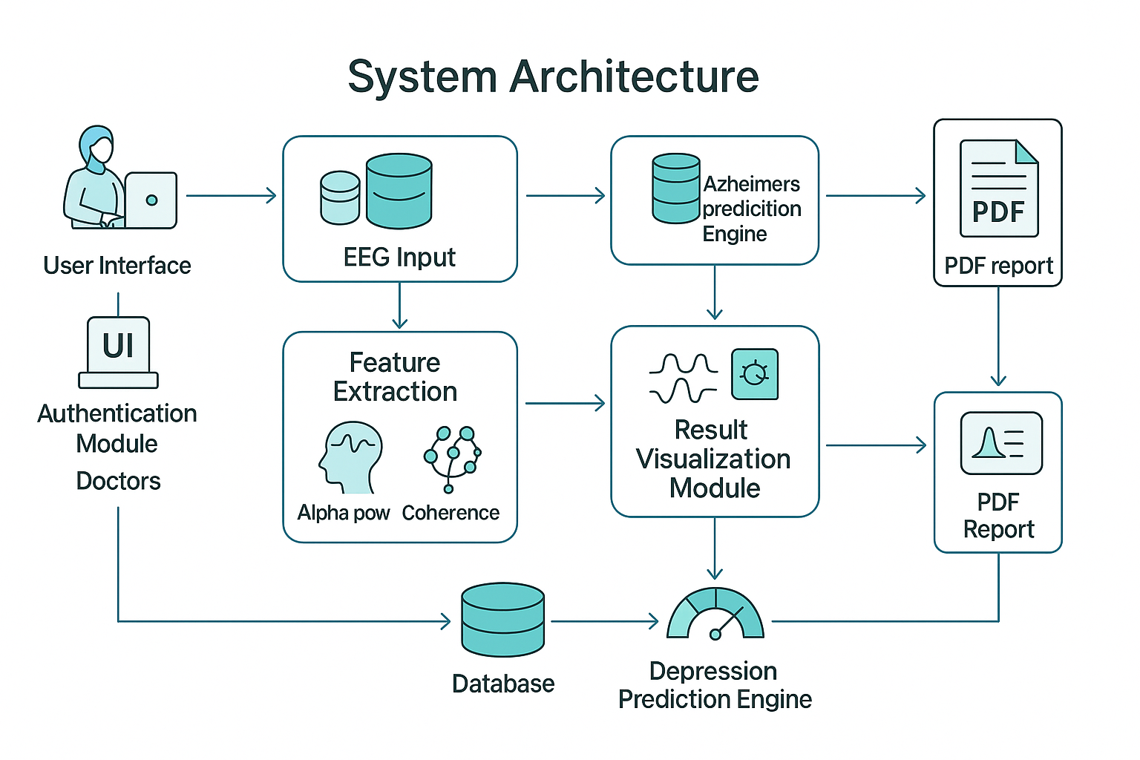
FLOW DIAGRAM

Slide 17





MODULES
MODULE 1
MODULE 2
MODULE 3
MODULE 4
Data Acquisition & Management Module:
Handles the secure upload and storage of EEG datasets (.set files) within the application. It utilizes the MNE library to parse raw neurological data and extract channel-specific information for processing.
Signal Preprocessing & Visualization Module :
Responsible for filtering raw signals to remove artifacts and generating time-domain waveform plots. This module converts raw arrays into visual images, allowing clinicians to verify signal quality before analysis.
Spectral Feature Extraction Module:
Implements mathematical signal processing using SciPy to perform Fast Fourier Transforms (FFT). It isolates specific frequency bands (Alpha, Theta) and calculates Power Spectral Density (PSD) for biomarker identification.
Connectivity Analysis Module:
Computes functional connectivity metrics, specifically Magnitude Squared Coherence, between brain regions. It measures the synchronization between Frontal (Fz) and Occipital (O1/O2) channels to detect network disruptions.

Slide 18
MODULES
MODULE 5
MODULE 2
MODULE 3
MODULE 4
Alzheimer’s Classification Engine:
A machine learning subsystem that segments signals into 10-second epochs and applies a Centroid Classifier. It aggregates "Control" vs. "Abnormal" votes across epochs to output a final disease probability score.
Depression Risk Assessment Module :
A deterministic logic module that calculates the Alpha Asymmetry Index between hemispheric channels. It maps the imbalance of frontal/occipital activity to a normalized percentage representing depression risk.
Web Interface & Session Management
Module:
The Flask-based application layer that manages routing, user sessions, and template rendering. It orchestrates the flow of data between the Python backend and the HTML frontend for a seamless user experience.
Automated Reporting & Decision Support:
Dynamically generates diagnostic reports with patient details, visual gauges, and calculated biomarkers. It includes a logic engine that interprets risk scores to provide specific clinical, lifestyle, and dietary recommendations.

Slide 19
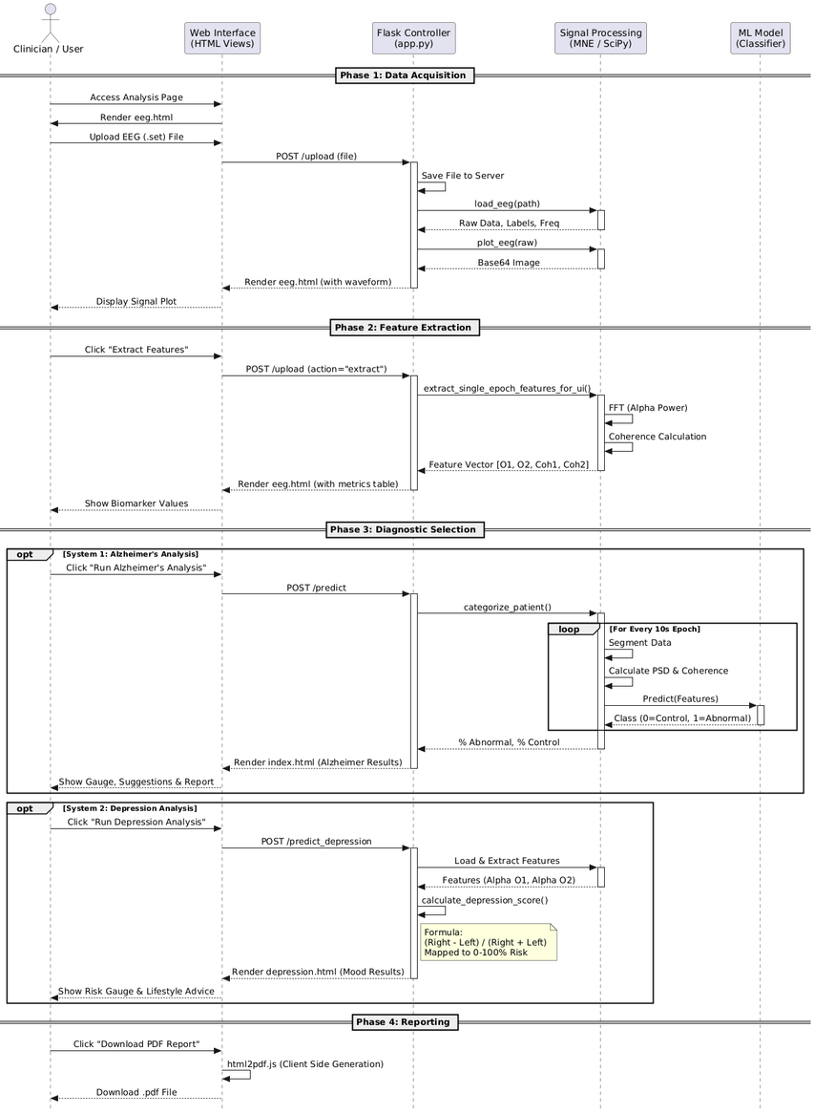
SEQUENCE DIAGRAM

Slide 20
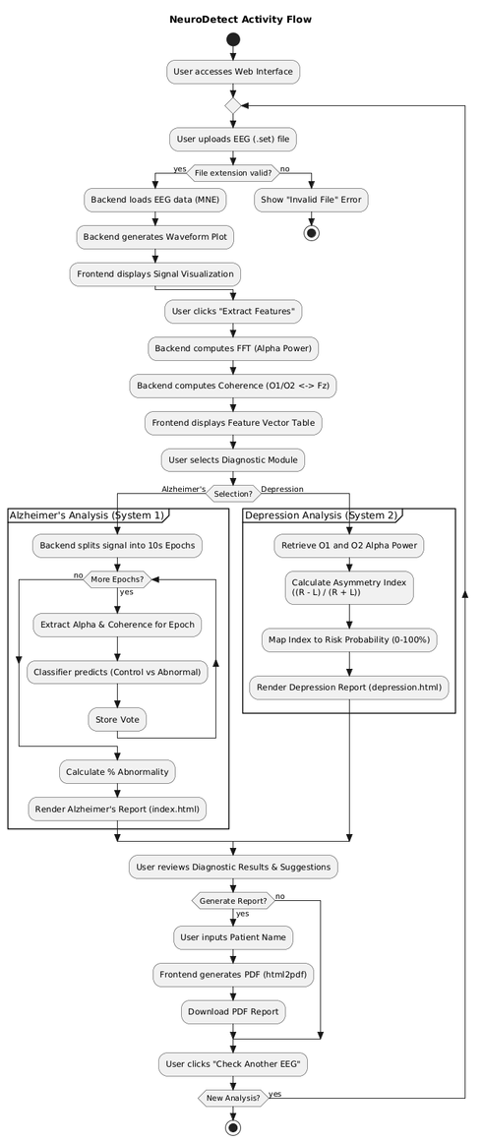
ACTIVITY DIAGRAM

Slide 21
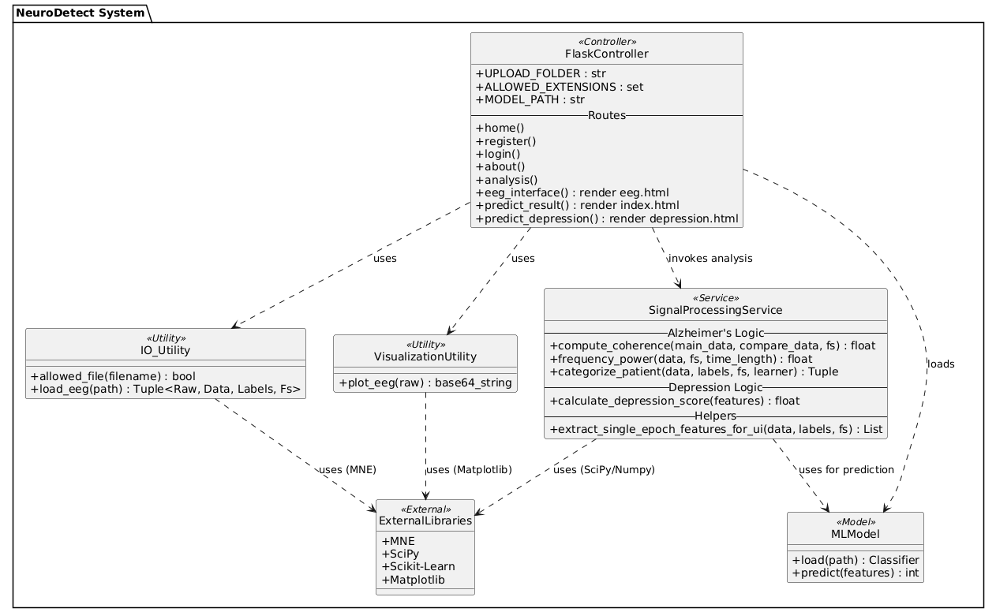
CLASS DIAGRAM

Slide 22
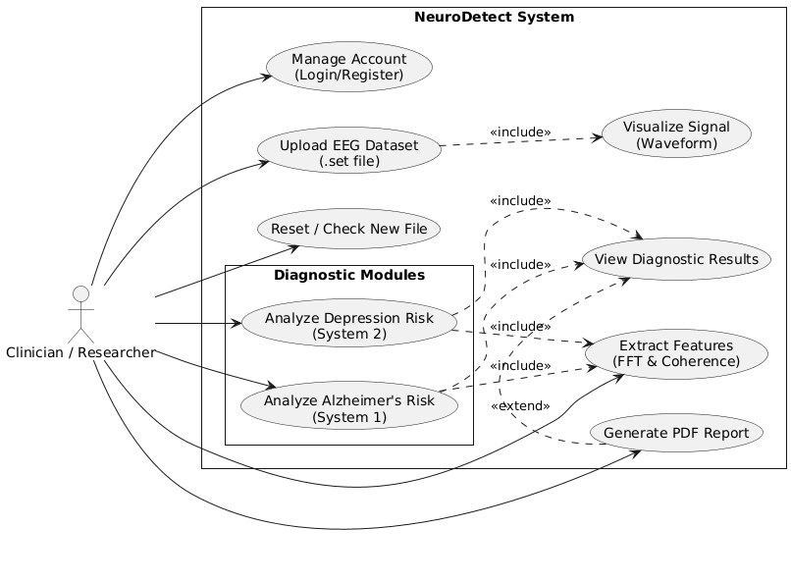
UML DIAGRAM

Slide 23






ADVANTAGES
Low-cost, rapid, and non-invasive
Works with standard EEG equipment
Highly interpretable clinical metrics
Reduces human error in EEG evaluation
Supports early intervention decision-making
Generates standardized digital reports

Slide 24
HARDWARE/SOFTWARE REQUIREMENT
HARDWARE REQUIREMENTS:
System : Pentium i3 Processor.
Hard Disk : 20 GB.
Monitor : 15’’ LED
Input Devices : Keyboard, Mouse
Ram : 4 GB
SOFTWARE REQUIREMENTS:
Operating system : Windows 10 Pro, MAC OS
Coding Language : Python 3.10.9, HTML, CSS,JS
Web Framework : Flask

Slide 25

CONCLUSION
NeuroDetect successfully transforms raw EEG data into clear, clinically actionable diagnostics.
Reliable classification of Alzheimer’s patterns using Alpha Power & Coherence
Depression asymmetry model provides consistent risk estimates
It accelerates early detection of neurodegenerative and mood disorders by blending AI, biomedical signal processing, and accessible web technology.
The system eliminates manual bottlenecks and brings laboratory-grade EEG analysis to everyday clinical environments.

Slide 26
REFERENCE
[1] WHO Recommendations for Prevention and Treatment of Pre Eclampsia and Eclampsia. Geneva: World Health Organization; 2011. 5, Research implications.
[2] Aljameel SS, Alzahrani M, Al Musharraf R, Altukhov M, Alshaia S, Sahlouli H, Aslam N, Khan IU, Alabbad DA, Alsumayt A. Prediction of Pre-eclampsia Using Machine Learning and Deep Learning Models: A Review.
[3] Li S, Wang Z, Vieira LA, Zheutlin AB, Ru B, Schadt E, Wang P, Copperman AB, Stone JL, Gross SJ, Kao YH, Lau YK, Dolan SM, Schadt EE, Li L. Improving pre-eclampsia risk prediction by modelling pregnancy trajectories from routinely collected electronic medical record data. NPJ Digit Med. 2022 June
[4] Yadav, S., Khandpur, S., Yadav, Y. S., Goel, M. M., Singh, U., Natu, S. M., ... & Tiwari, S. (2022). Model for Early Prediction of Pre-eclampsia: A Nested Case Controlled Study in Indian Women. The Journal of Obstetrics and Gynecology of India, 72(4), 299-306.
[5] Ranjbar, A., Montazeri, F., Ghamsari, S.R. et al. Machine learning models for predicting pre-eclampsia: a systematic review. BMC Pregnancy Childbirth 24, 6 (2024).

Slide 27







RESOURCES

